Slide 1
CHIPKO MOVEMENT

Slide 2
INDEX
1)What is CHIPKO ANDOLAN?
2)Introduction
3)Participants
4)Beginnings and Organizations
5)Far-Reaching Effect
6)Legacy
7)Women’s Participation

Slide 3

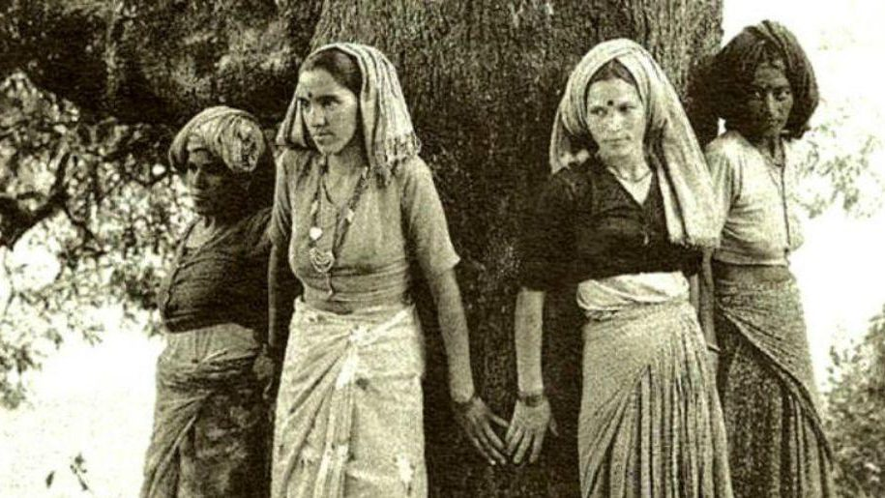
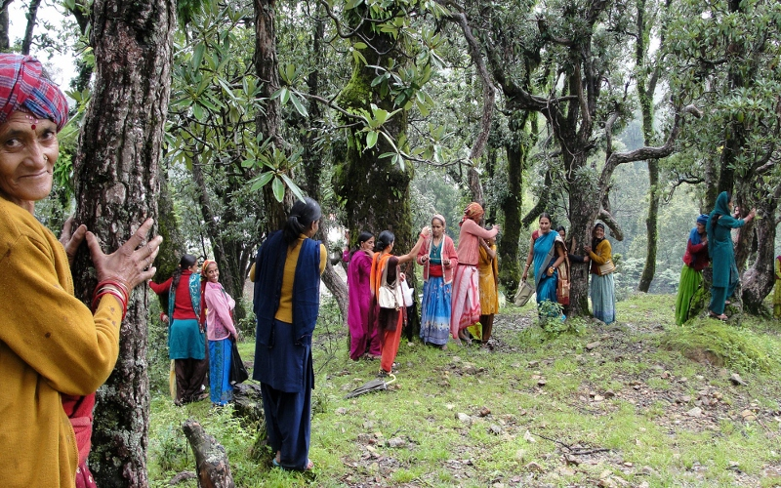
What is Chipko Andolan ?
The Chipko movement or Chipko Andolan, was a forest conservation movement in India. It began in 1970s in Uttarakhand, then a part of Uttar Pradesh (at the foothills of Himalayas) and went on to become a rallying point for many future environmental movements all over the world.

Slide 4


Introduction:
It created a precedent for starting nonviolent protest in India, and its success meant that the world immediately took notice of this non-violent movement, which was to inspire in time many similar eco-groups by helping to slow down the rapid deforestation, expose vested interests, increase social awareness and the need to save trees, increase ecological awareness, and demonstrate the viability of people power.

Slide 5
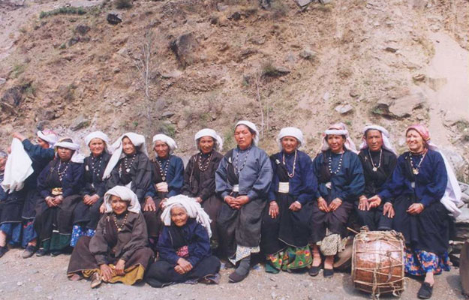
PARTICIPANTS:
One of Chipko's most salient features was the mass participation of female villagers.^{[19]} As the backbone of Uttarakhand's Agrarian economy, women were most directly affected by environmental degradation and deforestation, and thus related to the issues most easily. How much this participation impacted or derived from the ideology of Chipko has been fiercely debated in academic circles.^{[20]}

Slide 6
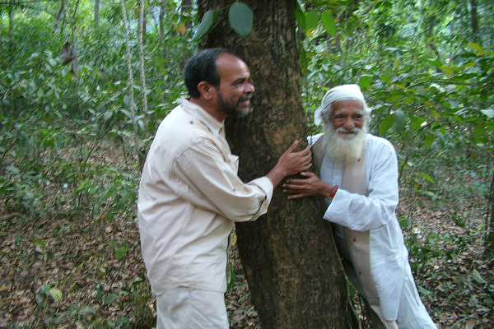

Despite this, both female and male activists did play pivotal roles in the movement including Gaura Devi, Sudesha Devi, Bachni Devi, Chandi Prasad Bhatt, Sundarlal Bahuguna, Govind Singh Rawat, Dhoom Singh Neji, Shamsher Singh Bisht and Ghanasyam Raturi, the Chipko poet, whose songs are still popular in the Himalayan region.Chandi Prasad Bhatt was awarded the Ramon Magsaysay Awar in 1982,^{[21]} and Sunderlal Bahuguna was awarded the Padma Vibhushan in 2009.

Slide 7
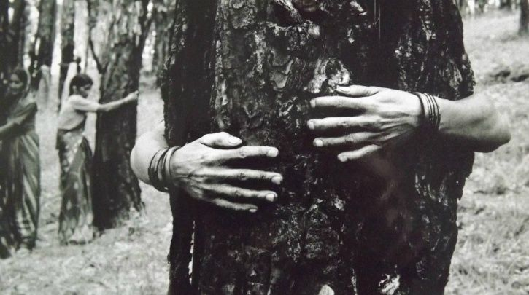
Beginnings and Organizations
Soon villagers and women, began to organise themselves under several smaller groups, taking up local causes with the authorities, and standing up against commercial logging operations that threatened their livelihoods. In October 1971, the Sangha workers held a demonstration in Gopeshwar to protest against the policies of the Forest Department. More rallies and marches were held in late 1972, but to little effect, until a decision to take direct action was taken. The first such occasion occurred when the Forest Department turned down the Sangh's annual request for ten ash trees for its farm tools workshop, and instead awarded a contract for 300 trees to Simon Company, a sporting goods manufacturer in distant Allahabad, to make tennis racquets.

Slide 8
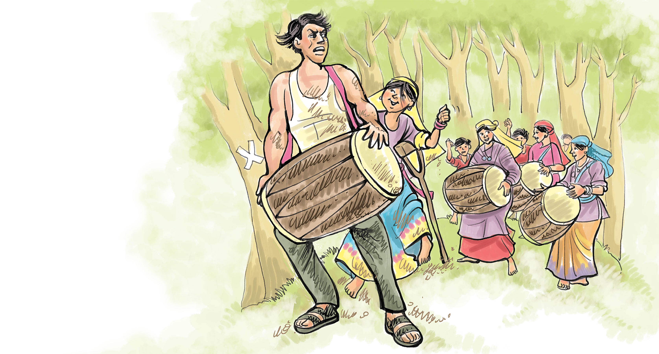
In March 1973, the lumbermen arrived at Gopeshwar, and after a couple of weeks, they were confronted at village Mandal on 24 April 1973, where about hundred villagers and DGSS workers were beating drums and shouting slogans, thus forcing the contractors and their lumbermen to retreat.

Slide 9
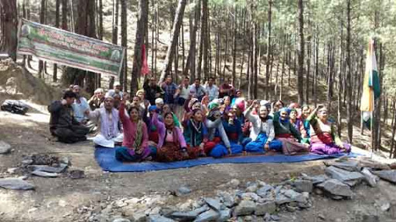
FAR-REACHING EFFECT
The news soon reached the state capital, where the then state Chief Minister, Hemwati Nandan Bahuguna, set up a committee to look into the matter, which eventually ruled in favour of the villagers. This became a turning point in the history of eco-development struggles in the region and around the world.
The struggle soon spread across many parts of the region, and such spontaneous stand-offs between the local community and timber merchants occurred at several locations, with hill women demonstrating their new-found power as non-violent activists. As the movement gathered shape under its leaders, the name Chipko movement was attached to their activities. According to Chipko historians, the term originally used by Bhatt was the word "angalwaltha" in the Garhwali language for "embrace", which later was adapted to the Hindi word, Chipko, which means to stick.Over the next five years, the movement spread to many districts in the region, and within a decade throughout the Uttarakhand Himalayas.

Slide 10
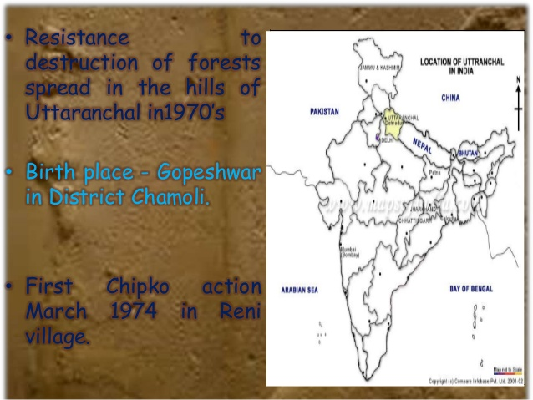
Larger issues of ecological and economic exploitation of the region were raised. The villagers demanded that no forest-exploiting contracts should be given to outsiders and local communities should have effective control over natural resources like land, water, and forests. They wanted the government to provide low-cost materials to small industries and ensure development of the region without disturbing the ecological balance. The movement took up economic issues of landless forest workers and asked for guarantees of minimum wage. Globally Chipko demonstrated how environment causes, up until then considered an activity of the rich, were a matter of life and death for the poor, who were all too often the first ones to be devastated by an environmental tragedy. Several scholarly studies were made in the aftermath of the movement.In 1977, in another area, women tied sacred threads, called Rakhi, around trees destined for felling. According to the Hindu tradition of Raksha Bandhan, the Rakhi signifies a bond between brother and sisters. They declared that the trees would be saved even if it cost them their lives.

Slide 11
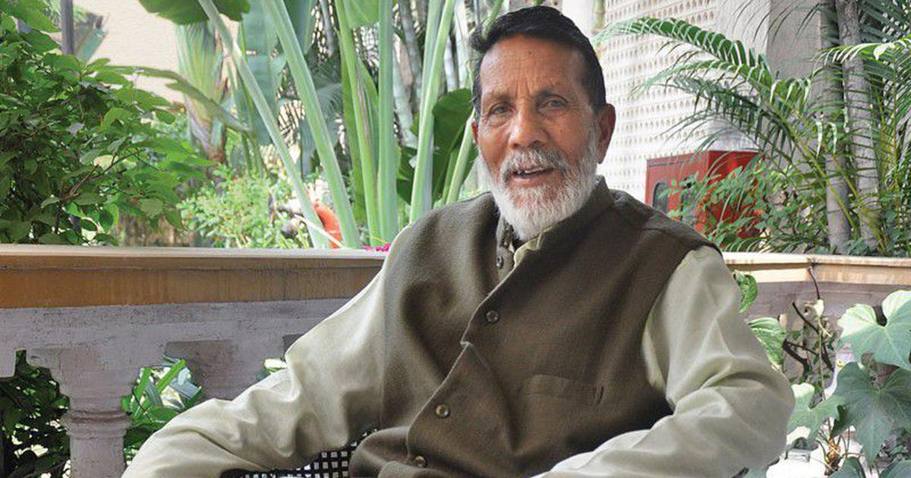
Chipko Andolan pioneer : Chandi Prasad Bhatt

Slide 12


Legacy:
In Tehri District, Chipko activists would go on to protest limestone mining in the Doon Valley in the 1980s, as the movement spread through the Dehradun district, which had earlier seen deforestation of its forest cover leading to heavy loss of flora and fauna. Finally quarrying was banned after years of agitation by Chipko activists, followed by a vast public drive for afforestation, which turned around the valley, just in time. Also in the 1980s, activists like Bahuguna protested against construction of the Tehri dam on the Bhagirathi River, which went on for the next two decades, before founding the Beej Bachao Andolan, the Save the Seeds movement, that continues to the present day.

Slide 13
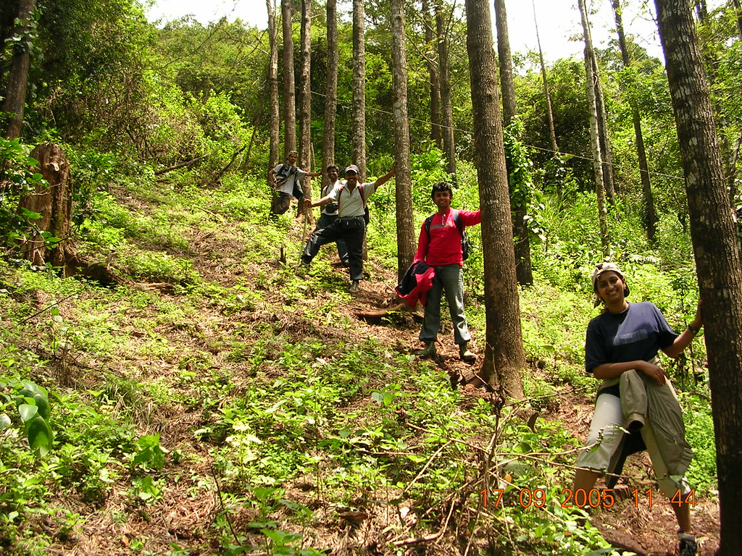
Over time, as a United Nations Environment Programme report mentioned, Chipko activists started "working a socio-economic revolution by winning control of their forest resources from the hands of a distant bureaucracy which is only concerned with the selling of forestland for making urban-oriented products". The Chipko movement became a benchmark for socio-ecological movements in other forest areas of Himachal Pradesh, Rajasthan and Bihar; in September 1983, Chipko inspired a similar, Appiko movement in Karnataka state of India, where tree felling in the Western Ghats and Vindhyas was stopped. In Kumaon region, Chipko took on a more radical tone, combining with the general movement for a separate Uttarakhand state, which was eventually achieved in 2001

Slide 14
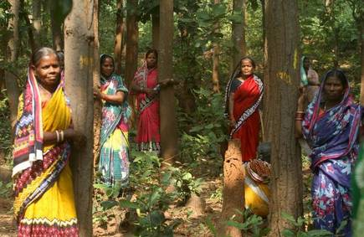
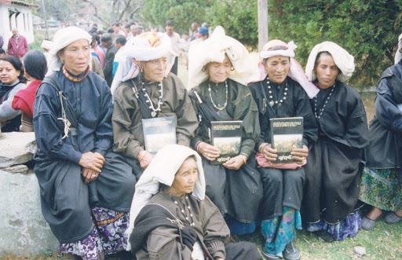
WOMEN’S ROLE IN CHIPKO ANDOLAN
The Chipko Movement has attracted world-wide attention. The image of poor, rural women in the hills of northern India standing with their arms around trees to prevent them being cut down is a romantic and compelling one. The reality, in many ways, fits the image: the Chipko Movement can indeed be considered an important success story in the fight to secure women's rights, in the process of local community development through forestry and in environmental protection. But there are more complicated implications as well. It is important to understand the history of Chipko and the context in which it arose - and is still evolving.

Slide 15


